Slide 1
Overview of Bayesian mixing models
Eric Ward
August 29 2014
eric.ward@noaa.gov

Slide 2
Outline
Evolution of mixing models from IsoSource forward
Understanding priors in Bayesian mixing models
Challenges / future work

Slide 3
Objective
Estimate the relative proportions (‘p’) of ‘m’ sources to a mixture with t tracers (d13C, d15N, d18O)
Widely range of applications (hydrology, geology, chemistry, ecology)
Data don’t have to be stable isotopes (FAs, soil samples)
Additional complications in ecology / diet studies
Account for isotope specific fractionation / TEFs
Concentration dependence: different food sources may contain different amounts of C/N – omnivores may have more dN15 from animals than plants (Phillips & Koch 2002)
Assimilation efficiency / digestibility (Martinez del Rio & Wolf 2005, Chiaradia et al. 2014)

Slide 4
IsoSource (Phillips & Gregg 2003)
Visual Basic program
Good at examining range of potential source combinations
User specified tolerance controls what solutions are acceptable
Not likelihood based
Doesn’t incorporate uncertainty in sources
As it’s not Bayesian, the ranges of solutions can’t be interpreted as probabilities
Though in some cases the ranges give similar solutions to more recent mixing models
http://www.epa.gov/wed/pages/models/stableIsotopes/isosource/isosource.htm

Slide 5
MixSIR (Moore & Semmens 2008)
MATLAB code / GUI
First Bayesian mixing model
User inputs: source & consumer signatures, isotope specific TEFs
User can input priors from other studies
Assumes all consumers to have the same mean diet
Variance of mixture = f(proportions, source variances)
http://conserver.iugo-cafe.org/

Slide 6
Semmens et al. (2009)
First hierarchical mixing model
Includes both fixed / random effects
Multiple layers of nested random effects
Code published with paper, no separate software
Also illustrates a complication in working with compositional data: need to some transformation (CLR, ILR, multivariate logit)
*Check out compositions() package in R!
http://conserver.iugo-cafe.org/

Slide 7
SIAR (Parnell et al. 2010)
Menu driven interface in R
Same basic assumptions as MixSIR
BUT extra isotope-specific additive residual error estimated
Also includes concentration dependence (MixSIR does not)
Need multiple consumers to estimate residual error
GUI also allows SIAR model to be applied to different groups (factors)
http://cran.r-project.org/web/packages/siar/index.html

Slide 8
Ward et al. (2010)
“Fully Bayesian” versions of MixSIR / SIAR
Flexible, incorporates uncertainty in source means / variances
Code published with paper, no separate software
By treating sources as parameters, informative priors can be useful
http://conserver.iugo-cafe.org/

Slide 9
Francis et al. 2011
Extension of MixSIR / SIAR to include continuous covariates
Application was on 1-D, but easily extendable to 2D
Code provided with paper, not separate software
There are (m-1) slope / intercepts estimated, so more parameters than basic regression!
http://onlinelibrary.wiley.com/doi/10.1111/j.1461-0248.2011.01597.x/abstract

Slide 10
Solomon et al. 2011
3 source model (C, N, H)
Extended mixing model to include extra source (H²0) for H
Software included with paper, not separate package
Extra tracer improves ability to discriminate
Makes Dirichlet prior slightly more complex, because the number of sources varies by isotope / tracer
http://limnology.wisc.edu/personnel/jakevz/pdf/2011_Solomon_etal_Ecology.pdf

Slide 11
IsotopeR (Hopkins & Ferguson 2012)
R package incorporating models through 2010
Also includes measurement error (mass spec)
Also includes correlation between sources
e.g. C/N sometimes positively correlated
Incorporating this correlation may yield better predictions / estimation
http://cran.r-project.org/web/packages/IsotopeR/index.html

Slide 12
MixSIAR
Fusion of previous tools
New features:
User friendly GUI
Grouping variables may be fixed / random
Hierarchical models
Inclusion of covariates
New options for modeling residual errors (soon!)
Data can be input in a number of formats
Source means / variances
Very active SIAR / MixSIAR Facebook group (led by A. Jackson)
Lots of users helping eachother
FB group: https://www.facebook.com/pages/SIAR-Stable-Isotope-Analysis-in-R/148501811896914
MixSIAR: https://github.com/brianstock/MixSIAR

Slide 13
Field is evolving rapidly
Improvements in theory (Parnell et al. 2013)
“kitchen sink” mixing model
Lots of potential parameters that can be estimated with other types of data, informed by priors, etc
Many tangential applications
http://onlinelibrary.wiley.com/doi/10.1002/env.2221/abstract

Slide 14
Yeakel et al. 2011
One potential flaw with all previous approaches is that the available biomass of all sources is assumed equal
Demonstrated post-hoc resampling with MixSIR – but is broadly applicable to all other models
Moose v mice
Script provided with paper, not separate software
http://www.plosone.org/article/info%3Adoi%2F10.1371%2Fjournal.pone.0022015

Slide 15
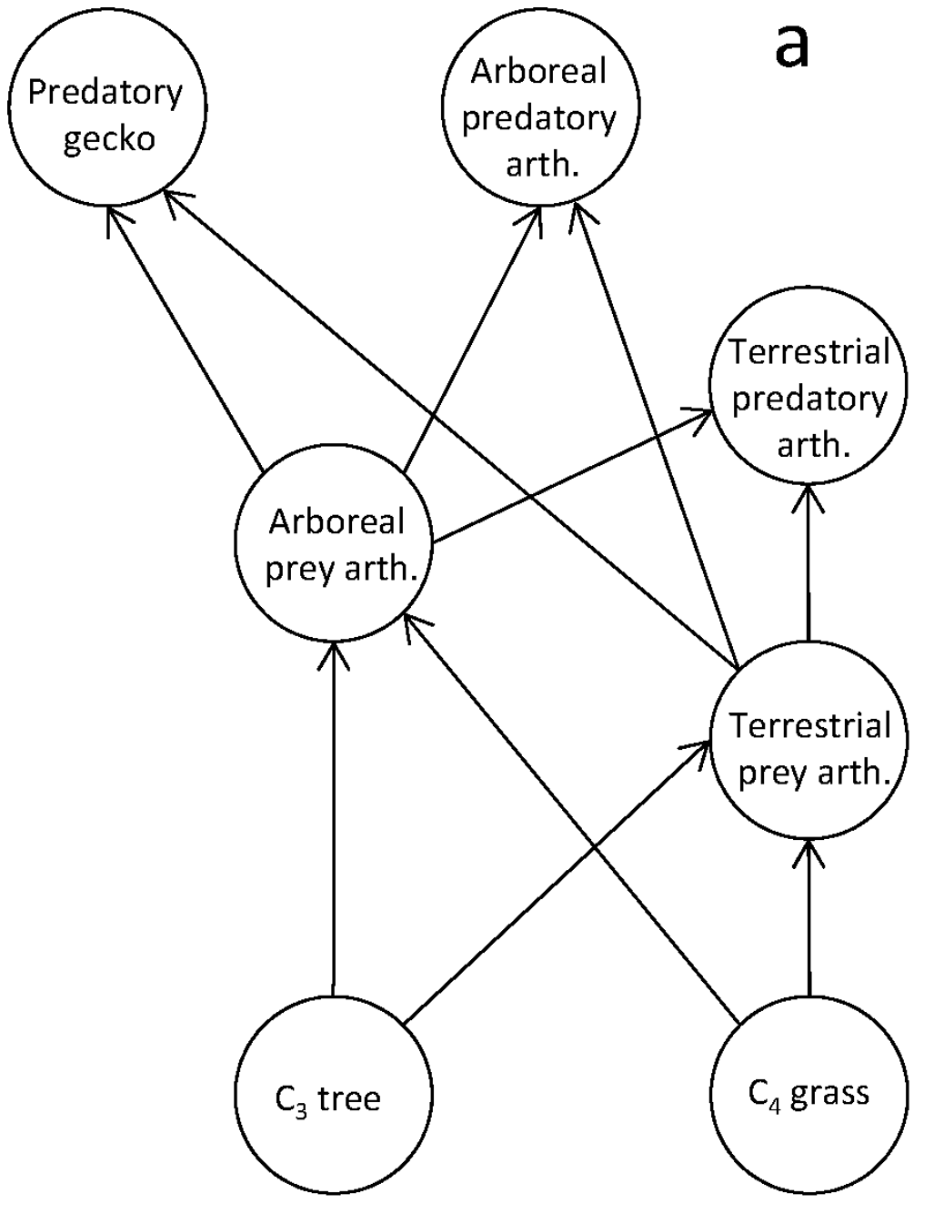
IsoWeb (Kadoya et al. 2012)
User inputs food web structure & SI values
Incorporates uncertainty in TEFs
Can compare likelihood of different food web topologies
Script available with paper, not separate software
http://www.plosone.org/article/info%3Adoi%2F10.1371%2Fjournal.pone.0041057

Slide 16
SISUS (Erhardt et al. 2014)
Update / improvement on IsoSource
Estimates ranges of feasible proportions
Like isosource, not to be confused with Bayesian mixing models
Used to be available as an R package, but defunct as of 08-2014
http://statacumen.com/sisus/

Slide 17
FRUITS (Fernandes et al. 2014)
Mixing model that incorporates dietary routing
Incorporates differential weight of sources
More mechanistic mixing model
Need additional priors from feeding studies, experiments, etc.
Software as R package on sourceforge
http://www.plosone.org/article/info%3Adoi%2F10.1371%2Fjournal.pone.0087436

Slide 18
Outline
Evolution of mixing models from IsoSource forward
Understanding priors in Bayesian mixing models
Challenges / future work

Slide 19
Priors on proportions
All mixing models treat proportions (p) as estimated parameters
We assign a Dirichlet distribution as the prior
Constrained to sum to 1
For ‘m’ sources, there are ‘m-1’ parameters
Widely used in compositional data analysis
Very flexible, multivariate version of beta distribution
Hyperparameters = alpha = c(1, 1, 1) whose length is the same as the number of sources

Slide 20
Beta distribution
p1
p1
p1
Notes:
par(mfrow = c(3,1), mgp = c(2,1,0))
hist(rbeta(10000,1,1),col="grey",main="Beta (1, 1)", xlab="")
hist(rbeta(10000,1,10),col="grey", main = "Beta (1, 10)", xlab="")
hist(rbeta(10000,10,10),col="grey", main = "Beta (10, 10)", xlab="")

Slide 21
Dirichlet: sample size
Expected value of proportion i is just
= alpha_{i} / sum(alpha)
This means alpha = (1, 1, 1) and alpha = (10, 10, 10) have the exact same a priori means
BUT the larger the alphas are, the more weight they have (tighter prior)

Slide 22
Effect of increasing alpha
Notes:
library(compositions)
par(mfrow = c(3,1), mgp = c(2,1,0))
hist(rDirichlet.rcomp(10000, alpha = c(1,1,1)), breaks = seq(0,1,length.out=40),col="grey", main = "alpha = 1",xlab="p1",xlim=c(0,1))
hist(rDirichlet.rcomp(10000, alpha = c(10,10,10)), breaks = seq(0,1,length.out=40),col="grey", main = "alpha = 10",xlab="p1",xlim=c(0,1))
hist(rDirichlet.rcomp(10000, alpha = c(100,100,100)), breaks = seq(0,1,length.out=40),col="grey", main = "alpha = 100",xlab="p1",xlim=c(0,1))

Slide 23
Rough guide to interpretation
Alphas can roughly be interpreted as effective sample size
e.g. we’re interested in a mixing model using salmon as consumers. We have 300 sampled items from 43 stomachs that we’d like to use as a prior. How to construct alphas?
Relative ps = 0.1, 0.2, 0.7
Sample size = 10, alpha = c(1, 2, 7)
Sample size = 43, alpha = c(4.3 8.6 30.1)

Slide 24
Dirichlet: why ‘1’ is the default prior
The marginal distribution of the previous example doesn’t look uniform or ‘uninformative’
Very confusing, but this prior is uniform on the entire compositional simplex
In other words, all diet combinations are equally likely

Slide 25
Let’s look at this in > 1 dimension
Imagine we
have 3 sources
(= 2 parameters)
Notes:
library(gplots)
library(fields)
r = rDirichlet.rcomp(1000000, alpha = c(1,1,1))
hist2d(r[,1], r[,2], nbins = 50, same.scale = TRUE, col=tim.colors(10),xlab="p1", ylab="p2", main="3 source model, alpha = 1")

Slide 26
Notes:
library(gplots)
library(fields)
r = rDirichlet.rcomp(1000000, alpha = c(3,3,3))
hist2d(r[,1], r[,2], nbins = 50, same.scale = TRUE, col=tim.colors(10),xlab="p1", ylab="p2", main="3 source model, alpha = 3",xlim=c(0,1),ylim=c(0,1))

Slide 27
BUT we can also make the Dirichlet marginals look more ~ uniform
Wouldn’t that be better than alpha = 1?
Notes:
par(mfrow = c(3,1), mgp = c(2,1,0))
hist(rDirichlet.rcomp(10000, alpha = c(1,1,1)), breaks = seq(0,1,length.out=40),col="grey", main = "alpha = 1",xlab="p1",xlim=c(0,1))
hist(rDirichlet.rcomp(10000, alpha = c(0.6,0.6,0.6)), breaks = seq(0,1,length.out=40),col="grey", main = "alpha = 0.6",xlab="p1",xlim=c(0,1))

Slide 28
Nope! In 2D, extreme values given high weight

Slide 29
Dirichlet: impact of source geometry
In Bayesian statistics, we think of our estimates (posterior distribution) as
Pr(theta | data), but it should really be
Pr(theta | data, model)
model includes source geometry
Bad geometry can impact the prior

Slide 30
Adding 4th source to our example
1
Extreme example of 2 sources
that could be combined a priori
3/4
2
Notes:
plot(c(0, 0.5, 1),c(0,1,0), xlim=c(-0.1,1.1), cex=3,lwd=5,ylim=c(-0.1,1.1), xlab="",ylab="",axes=F)
points(0, 0, lwd = 5, cex=5, col="red")
box()

Slide 31
What this means for prior
This means that sources
1/2 are getting down
weighted, and sources 3/4
receive much more prior
mass
Notes:
library(gplots)
library(fields)
r = rDirichlet.rcomp(1000000, alpha = c(1,1,1,1))
hist2d(r[,1], r[,2], nbins = 50, same.scale = TRUE, col=tim.colors(10),xlab="p1", ylab="p2", main="4 source model, alpha = 1",xlim=c(0,1),ylim=c(0,1))

Slide 32
Priors on source means / variances
Ward et al. 2010 (“fully Bayesian model”)
Motivation: mixing model applications often have different #s of samples / source
Sample processing can be expensive, making sample sizes small
Var(sample mean) = sigma2 / n

Slide 33
Many mixing model studies live here

Slide 34
Freeing up mean / variance
Including this uncertainty in sample mean / variance can lead to better fits to the data
It also allows us to include prior information from other studies / systems (Ward et al. 2010)
Caution: because this is so flexible, very small sample sizes may result in source geometry shifting to fit the data better
Sample means / variance treated as parameters along with the proportions (and any other terms, like residual errors)

Slide 35
Mathematically
Other eqns in Ward et al. (2010)
this means posterior = weighted average of prior + sample mean

Slide 36
Outline
Evolution of mixing models from IsoSource forward
Understanding priors in Bayesian mixing models
Challenges / future work

Slide 37
“MixSIR / SIAR / MixSIAR” don’t work right for my dataset – PLEASE HELP!
You can only fit models as complex as your data will allow
Do the data violate any of the basic assumptions of mixing models?
Most mixing models are underdetermined (Sources > isotopes + 1; Fry 2013)

Slide 38
Geometry is critical & mixing models won’t solve problems (Phillips and Gregg 2003)

Slide 39
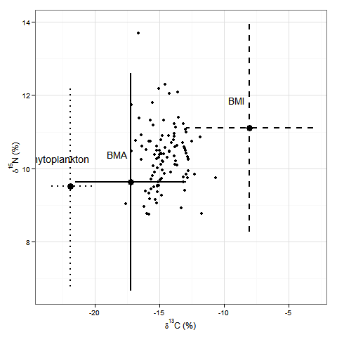
Essentially 1-D problem

Slide 40
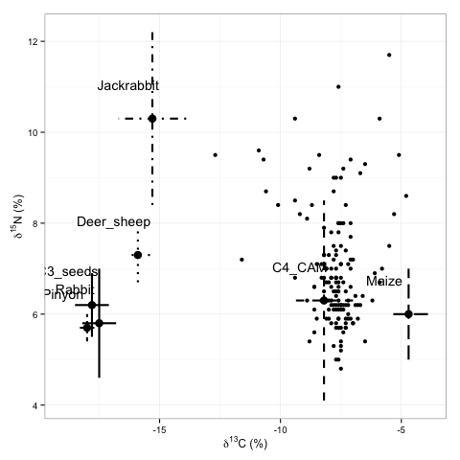
Confounded sources

Slide 41
Consumer signatures falling outside of resource polygon
Berggren et al. 2014, http://esapubs.org/archive/ecol/E095/171/appendix-C.pdf

Slide 42
If mixing models aren’t appropriate (bad geometry, other reasons)
SIBER (Jackson et al. 2011)
Test for differences among groups (e.g. Bodey et al. 2014 JAE)

Slide 43
Ongoing research
Including more than one data type in prior
Genetics, observational data, etc. (E. Ward)
Incorporating multiple data types in likelihood
‘fastinR’ FAs and SIs (Neubauer & Jensen 2014)
Quantifying bias in different models to experimental / real data (Brett, Galloway, others)
Using mixing models to estimate / infer movement (Carlisle et al. 2012, Phills et al.)
Simulating effect of missing sources on estimates (Phillips, Inger, etc)
More mechanistic mixing models (Stock & Semmens)

